Slide 1
The Challenge of Change
A webinar from Inside Higher Ed
Tuesday, May 16
2 p.m. Eastern

Slide 2
Presenters
Scott Jaschik, editor, Inside Higher Ed scott.jaschik@insidehighered.com
Doug Lederman, editor, Inside Higher Ed doug.lederman@insidehighered.com

Slide 3
Expect the Unexpected

Slide 4
Enrollment I: Overview
Almost everyone is tuition dependent.
Traditional patterns are eroding.
Everyone is competing with everyone.
Colleges have little margin for error.

Slide 5
Enrollment II: Strategy and Backlash
Recruiting out-of-state students seemed logical, and then state legislators had another view….

Slide 6
Enrollment III: Strategy Works and Conditions Change
Many colleges, public and private, invested considerable resources to build up undergraduate enrollment of international students.
Goals of 5-10% were common (up from just a handful of students in prior years).
Considerable progress achieved.
Trump election has many institutions worried about maintaining these enrollment levels.

Slide 7
Tuition Policy
Public colleges face one set of pressures.
Private colleges face another set of pressures.
Debt worries are a growing impact on public and private institutions.

Slide 8
Discount Rates

Slide 9
Diversity

Slide 10
New Models of Education
Badges
Boot camps
MOOC-inspired models
Mix and match

Slide 11
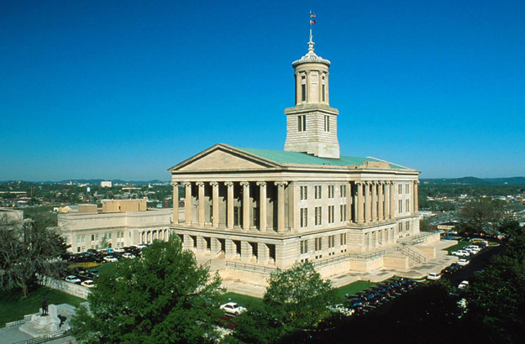
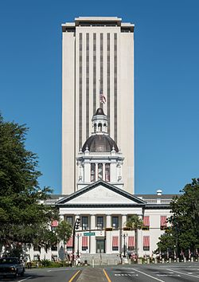
State Policy in Many Directions

Slide 12
The Trump Impact

Slide 13
Assessment

Slide 14
Preparing Students for Jobs

Slide 15
A Skeptical Public

Slide 16
What Hasn’t Changed (and Shouldn’t)

Slide 17
Q&A

Slide 18
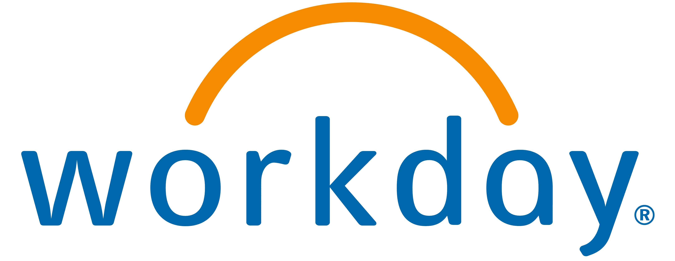
With Thanks …

